Slide 1
InterSystems IRIS for Health Legacy Data -> FHIR R4
Jeff Morgan
Sales Engineer

Slide 2
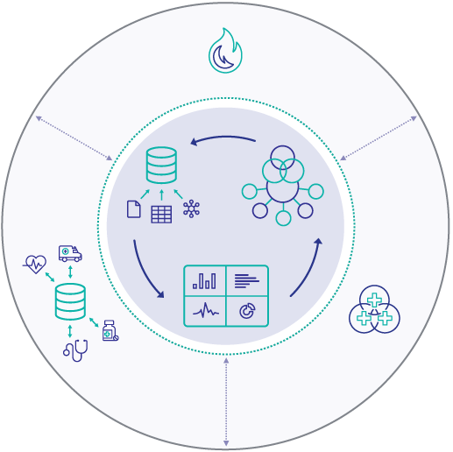
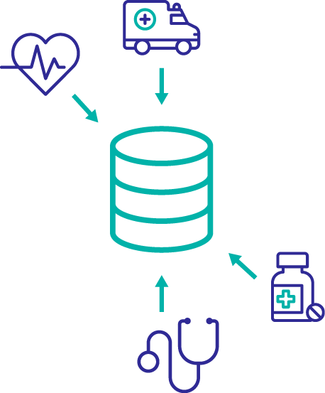

InterSystems IRIS for Health
InterSystems IRIS Analytics
InterSystems IRIS Database
InterSystems IRIS Interoperability
Healthcare
Protocols & Data Models

Slide 3
















Organize the complexity, simplify the application
Out-of-the-box healthcare interoperability
Canonical messaging data model
Many sources, one model for application development

Slide 4
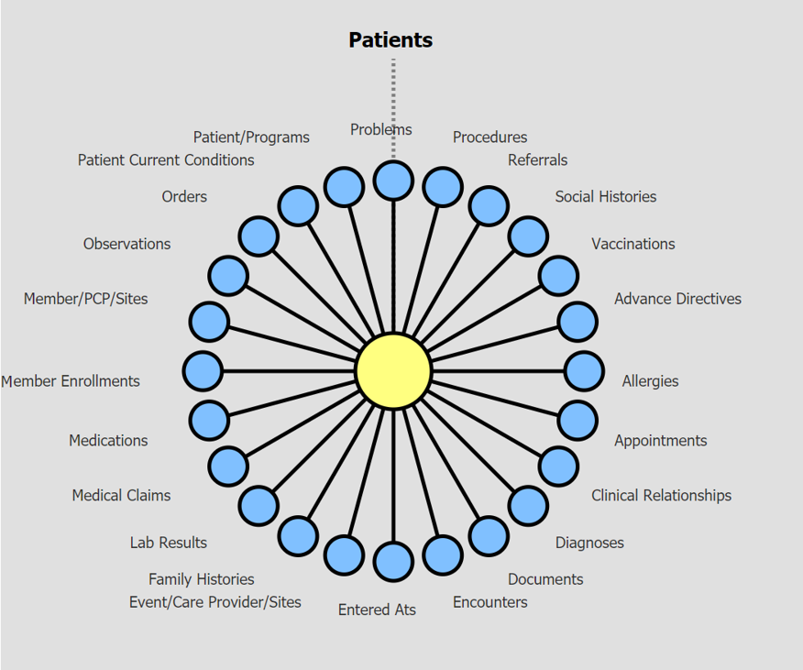
Upgrade Safe Extensible Data Model (Summary Document Architecture = SDA)
A comprehensive data model informed by Providers, InterSystems TrakCare EMR, HIEs, and Payers
Extensible data model that can process data from any source including clinical, claims, device, and non-traditional data
Upgrade safe customizations that enable proprietary data, ontologies, and standards for population health, quality, care management, patient engagement, and operations, etc.
IRIS for Health provides off the shelf and custom data validation at the point of ingestion
Clearinghouse quality HL7 v2 validation tool that validates every character in the message to HL7 standards
CDA validator for standard and custom data sources allowing for semantic rules out of the box and custom rules

Slide 5
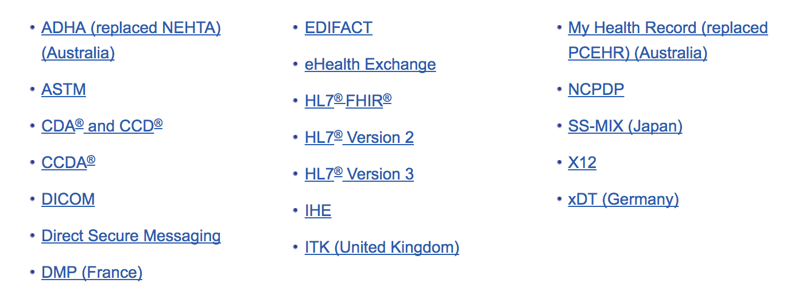
Out-of-the-box healthcare interoperability
IRIS for Health translations are optimized for all health standards, allowing faster time to market and lower TCO for development and management of clinical data solutions
CDA, C-CDA, C32, etc.
Flat Files / SFTP
IRIS for Health
REST/JSON/XML/SOAP
HL7 Version 2 / 3, Z Segments
X12
FHIR STU3 & R4
Custom

Slide 6

FHIR Support in IRIS for Health
Supports STU3 & R4
Key Features
FHIR Server & Client components supporting FHIR RESTful API
FHIR Resource Repository
Object model for FHIR resources
Message model for FHIR request & response messages
DTLs & class methods for conversion between FHIR and SDA
FHIR Annotations UI for viewing data mappings to/from SDA
FHIR-based IHE Profiles (PIXm, PDQm & MHD)
Notes:
FHIR Support

Slide 7
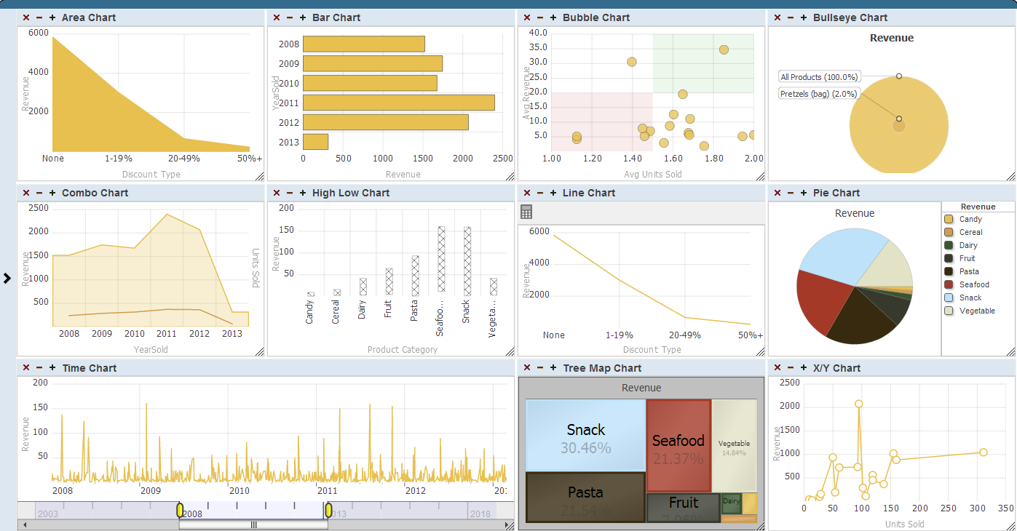
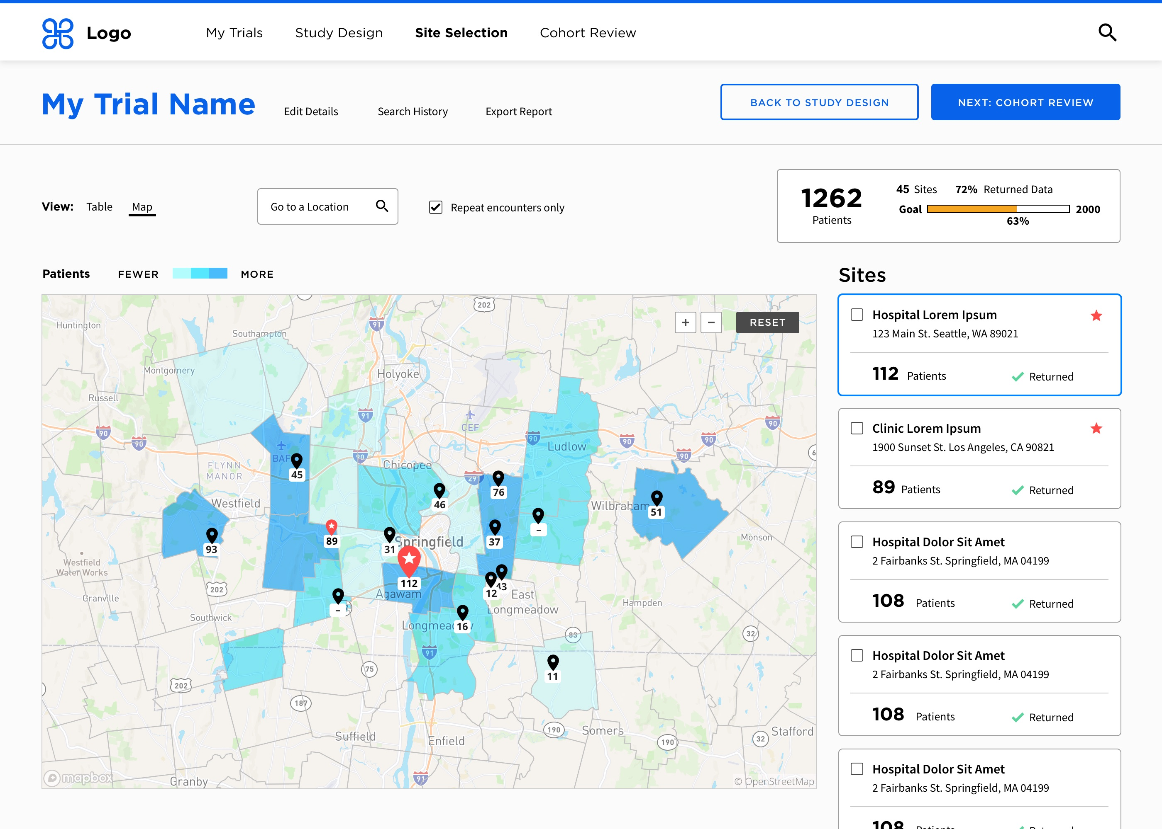
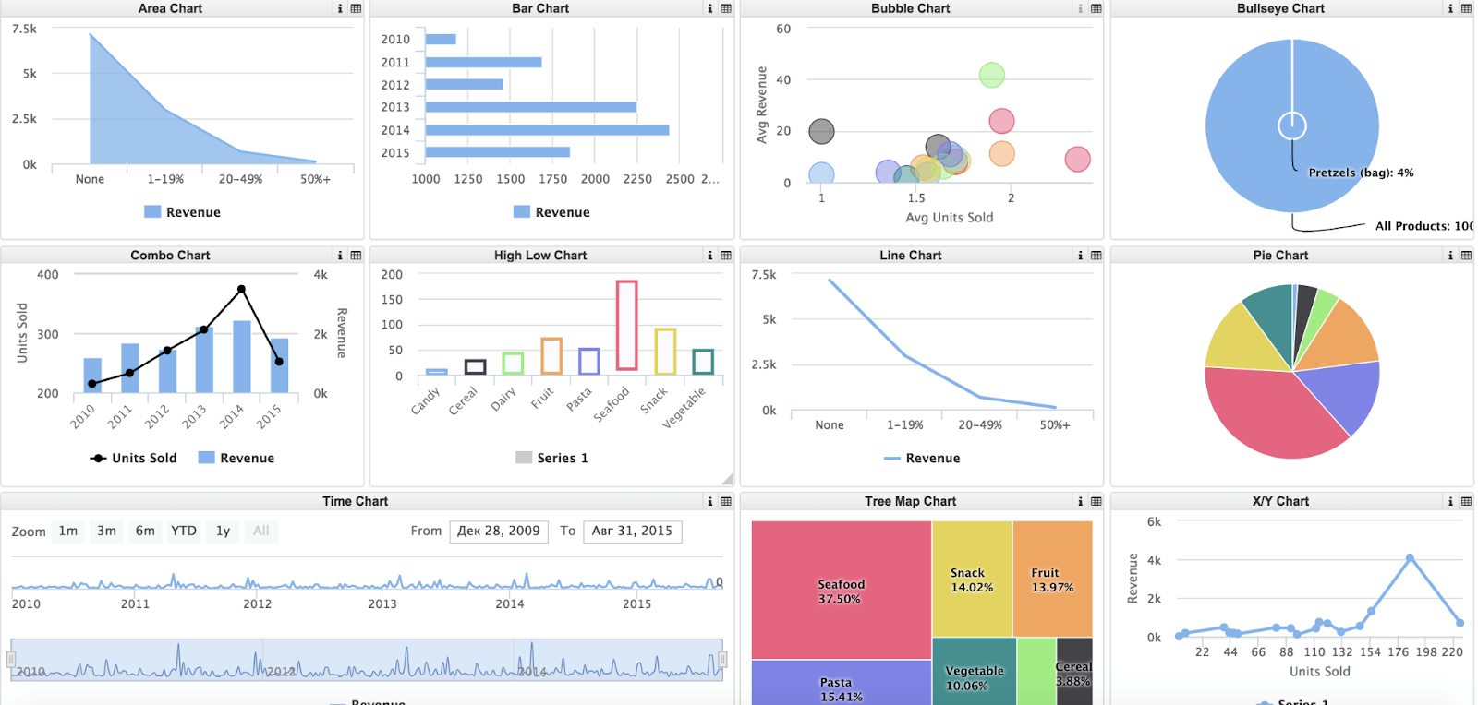






Analytics built in with easy access
IRIS analytics Query Engine
Source Data: structured & unstructured

Slide 8
Demonstration

Slide 9
Messaging Architecture
Adapters
Service
Process
Operation
Adapters
Technology
Technology
Rules Engine
Data Transformation
Vendors
Vendors
Process Orchestration
Workflow Engine
Standards
Standards
Message Repository
Metadata Visual Trace Activity Monitoring
Search/Edit/Resend Audit Log

Slide 10
Questions?

